Slide 1
Selecting a Data Structure
Select a data structure as follows:
Analyze the problem to determine the resource constraints a solution must meet.
Determine the basic operations that must be supported. Quantify the resource constraints for each operation.
Select the data structure that best meets these requirements.

Slide 2
Data Structure Philosophy
Each data structure has costs and benefits.
Rarely is one data structure better than another in all situations.
A data structure requires:
  space for each data item it stores,
  time to perform each basic operation,
  programming effort.

Slide 3
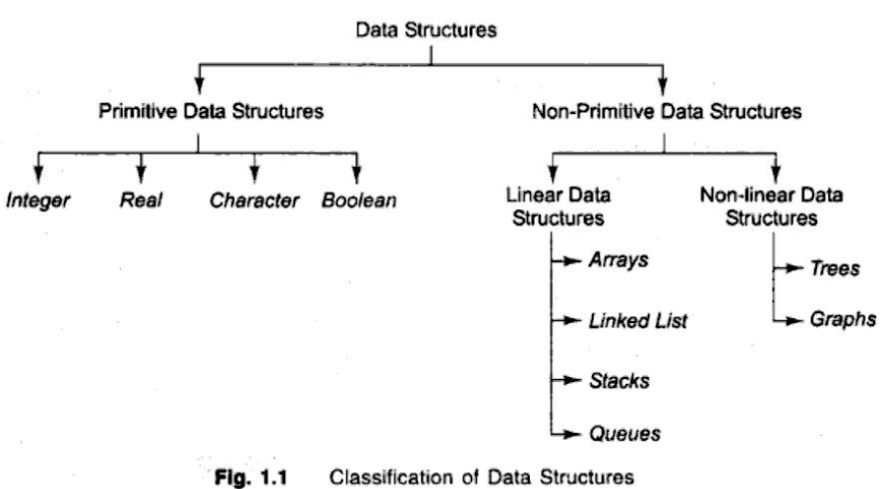

Slide 4
Arrays
Array declaration: int x[6];
An array is collection of cells of the same type.
The collection has the name ‘x’.
The cells are numbered with consecutive integers.
To access a cell, use the array name and an index:
x[0], x[1], x[2], x[3], x[4], x[5]

Slide 5
Array Layout (Linear-array)
x[0]
Array cells are contiguous in computer memory
The memory can be thought of as an array
x[1]
x[2]
x[3]
x[4]
x[5]

Slide 6
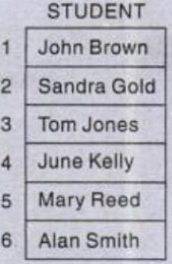


Linear(1-Dimensional Array)
A linear array A[8] consisting of numbers is pictured in following figure.

Slide 7
2-Dimensional Array
SALES is the name given to the Array

Slide 8
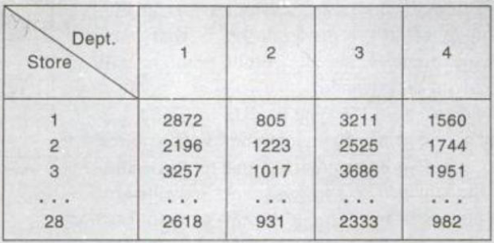
2-Dimensional Array

Slide 9
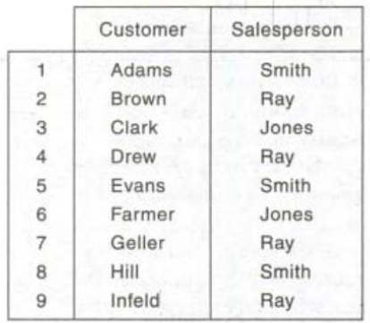
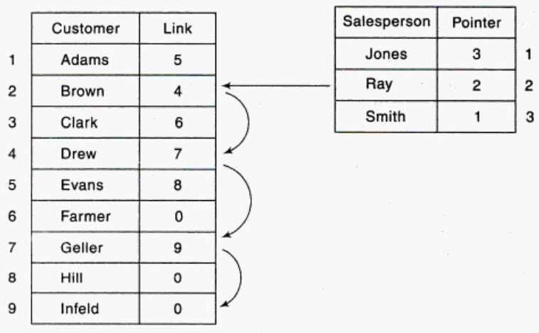
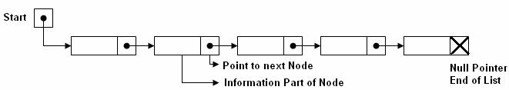
Link List

Slide 10
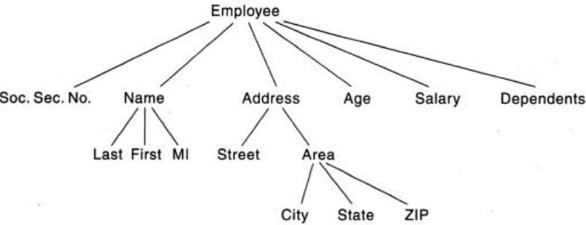
Tree

Slide 11
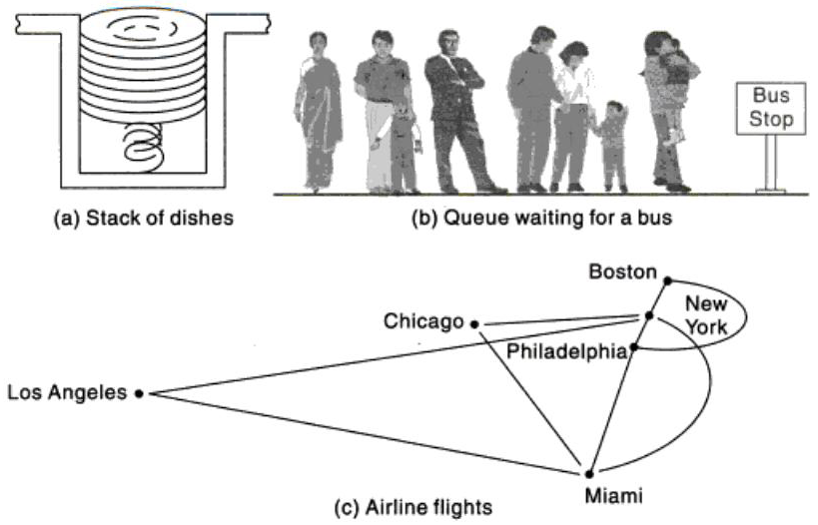

Slide 12
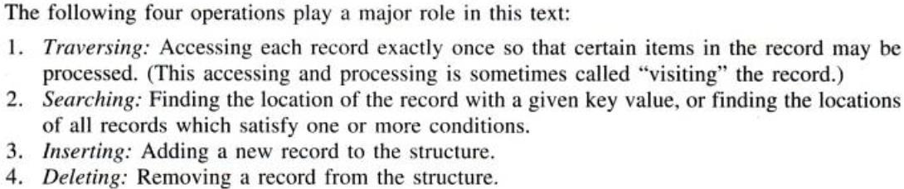
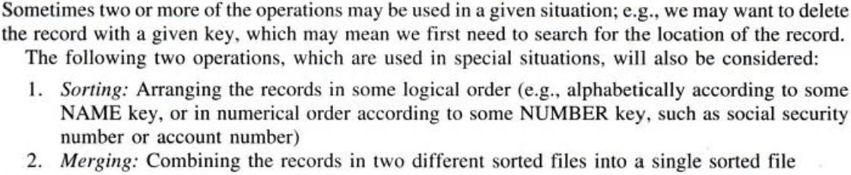
Data Structure Operations

Slide 13
Data Abstraction and Abstract Data Types (ADT)
A data type is a template for objects and a set of operations that define the behavior of the objects ( or Instances) of that type.
An abstract Data Type (ADT) is a data type in which the implementation details are hidden and the user is concerned with the properties ( or behavior) of that type.
An ADT has two components:
- Interface (the behavior)
- Implementation
Example:
- int, float

Slide 14
Abstract Data Type
The data structures used to implement the data type can only be accessed through the interface.
Any change in the implementation does not change the user programs as long as the interface remains the same
This is also known as the data encapsulation or data abstraction.
Implementation
Interface 1
Interface 2
Implementation
Interface 3
Interface 4

Slide 15
